Slide 1





虛擬世界中的悲傷：
原因、傷亡與應對策略
Thomas Chesney, Iain Coyne, Brian Logan, Neil Madden
Information Systems JournalVolume 19, Issue 6 p. 525-548
M11209201 資管碩一 莊椀晴
M11209202 資管碩一 黃雅婄
M11209218 資管碩一 黃奕瑄
01 / 19

Slide 2

目錄
01
02
03
04
05
研究背景
1
1
1
1
02 / 19

Slide 3

01
研究背景
03 / 19

Slide 4
1
1
03 / 19

Slide 5
1
1
03 / 19

Slide 6

02
研究方法

Slide 7

QUIZ CATEGORIES
Yes / No
True / False
Multiple Choice
Fill in the blanks
Enumeration
Video Question
MULTIPLE CHOICE
My sister got sad yesterday.
We __________ to buy her the cake she requested.
FORGET
FORGOT
WAS FORGETTING
HAVE FORGOTTEN
PART 2
11 / 19

Slide 8
表 3. Counts of observed griefing
這些行為對應於“六大”類別，並且使用了在霸凌、網路霸凌和惡意破壞部分中提供的編號進行分類。
Observer 2
Observer1 | Type | 1 | 2 | 3 | 4 | 5 | 6 | Totals
 | 1 | 2 | 0 | 0 | 0 | 0 | 1 | 3
 | 2 | 0 | 1 | 0 | 0 | 0 | 0 | 1
 | 3 | 0 | 0 | 2 | 0 | 0 | 1 | 3
 | 4 | 0 | 0 | 0 | 1 | 0 | 0 | 1
 | 5 | 1 | 0 | 0 | 0 | 8 | 1 | 10
 | 6 | 0 | 0 | 0 | 0 | 0 | 1 | 1
 | Totals | 3 | 1 | 2 | 1 | 8 | 4 | 19
03 / 19

Slide 9
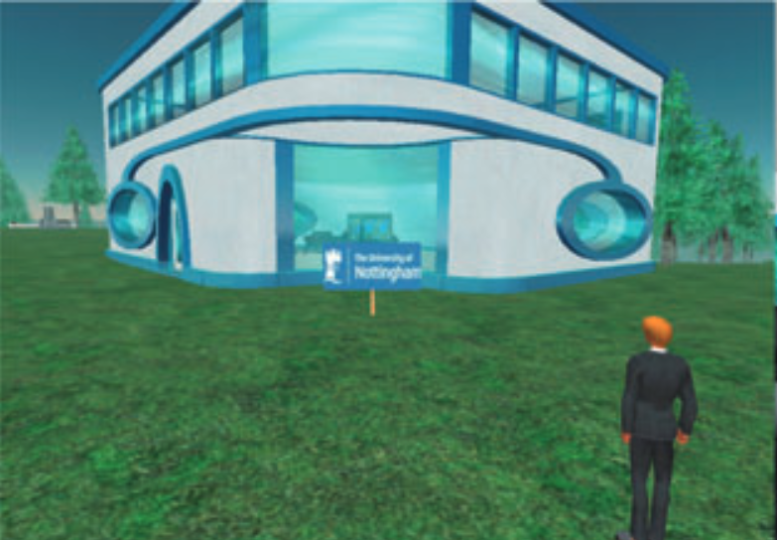
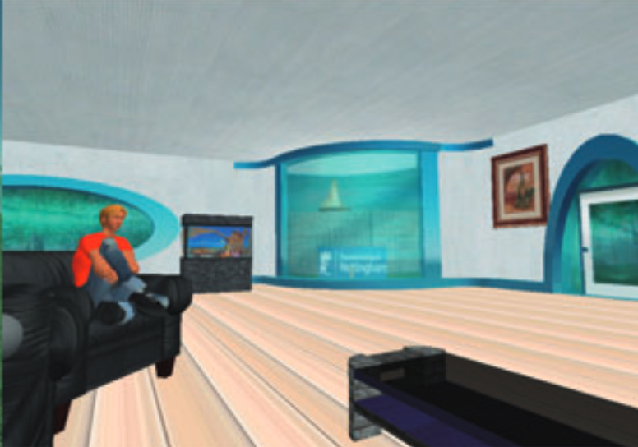
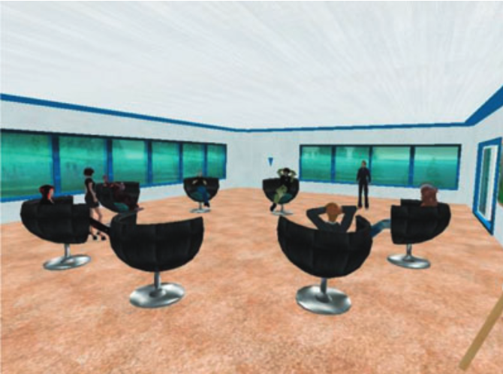
1
1
03 / 19

Slide 10
03
標題
10 / 19

Slide 11
1
1
03 / 19

Slide 12
1
1
03 / 19

Slide 13

04
標題
12 / 19

Slide 14
1
1
03 / 19

Slide 15
1
1
03 / 19

Slide 16

05
標題

Slide 17
1
1
03 / 19

Slide 18
1
1
03 / 19

Slide 19

06
結論

Slide 20
1
研究背景和目的
- 研究Second Life虛擬世界中的"griefing"(不當行為)現象
- 融合IS、職業心理學和計算機科學領域
研究方法
- 觀察和虛擬世界內焦點小組
- 收集數據識別griefing行為、影響、原因、應對和當事人
標題三: 主要研究結果
- Griefing是針對新手的持續不當行為,由資深用戶實施
- 應對策略:用戶社區集體利用控制權(如土地控制)處理騷擾者
標題四: 研究意義
- 對現有及未來虛擬世界界面具有啟示意義
- 展示了"虛擰世界內"研究的可行性和價值
標題五: 研究限制和未來方向
- 結果概括性有限,代表性樣本有待擴大
- 需要定量研究,彌補這一缺陷
- 虛擬世界有利於收集肇事者(欺凌者)數據,具獨特價值
03 / 19

Slide 21
1
1
03 / 19

Slide 22

謝謝聆聽
01 / 19

Slide 23
以下是模板

Slide 24
QUIZ CATEGORIES
YES / NO
TRUE / FALSE
MULTIPLE CHOICE
FILL IN THE BLANKS
ENUMERATION
VIDEO QUESTION
03 / 19

Slide 25
QUIZ TIME
Let's put your
knowledge to the test!
01 / 19

Slide 26
QUIZ CATEGORIES
Yes / No
True / False
Multiple Choice
Fill in the blanks
Enumeration
Video Question
A polygon that has five sides and five angles is called a pentagon.
YES / NO
PART 1
05 / 19

Slide 27
QUIZ CATEGORIES
Yes / No
True / False
Multiple Choice
Fill in the blanks
Enumeration
Video Question
A pentagon is a polygon with five sides and five angles. Its sides are equal.
YES / NO
PART 1
06 / 19

Slide 28
QUIZ CATEGORIES
Yes / No
True / False
Multiple Choice
Fill in the blanks
Enumeration
Video Question
Global warming is a condition where there is an excess of carbon dioxide.
TRUE / FALSE
PART 1
07 / 19

Slide 29
QUIZ CATEGORIES
Yes / No
True / False
Multiple Choice
Fill in the blanks
Enumeration
Video Question
Carbon dioxide and other air pollutants can last for years in the atmosphere, trapping heat and causing the planet to get warmer.
TRUE / FALSE
PART 1
08 / 19

Slide 30
PART 2

Slide 31
QUIZ CATEGORIES
Yes / No
True / False
Multiple Choice
Fill in the blanks
Enumeration
Video Question
MULTIPLE CHOICE
My sister got sad yesterday.
We __________ to buy her the cake she requested.
FORGET
FORGOT
WAS FORGETTING
HAVE FORGOTTEN
PART 2
11 / 19

Slide 32
QUIZ CATEGORIES
Yes / No
True / False
Multiple Choice
Fill in the blanks
Enumeration
Video Question
FILL IN THE BLANKS
The difference between “principal” and “principle” is __________.
PART 2
12 / 19

Slide 33
QUIZ CATEGORIES
Yes / No
True / False
Multiple Choice
Fill in the blanks
Enumeration
Video Question
FILL IN THE BLANKS
Principal means primary or first. Principle means a belief or a rule.
PART 2
13 / 19

Slide 34
PART 3
Difficult Round

Slide 35
QUIZ CATEGORIES
Yes / No
True / False
Multiple Choice
Fill in the blanks
Enumeration
Video Question
ENUMERATION
List the four main branches of science.
PART 3
15 / 19

Slide 36
QUIZ CATEGORIES
Yes / No
True / False
Multiple Choice
Fill in the blanks
Enumeration
Video Question
ENUMERATION
List the four main branches of science.
MATH AND LOGIC
BIOLOGICAL SCIENCE
PHYSICAL SCIENCE
SOCIAL SCIENCE
PART 3
16 / 19

Slide 37
QUIZ CATEGORIES
Yes / No
True / False
Multiple Choice
Fill in the blanks
Enumeration
Video Question
VIDEO QUESTION
Shameplant is a perennial flowering plant that closes when touched. What is its scientific name?
PART 3
17 / 19

Slide 38
QUIZ CATEGORIES
Yes / No
True / False
Multiple Choice
Fill in the blanks
Enumeration
Video Question
VIDEO QUESTION
Shameplant is a perennial flowering plant that closes when touched. What is its scientific name?
THE SCIENTIFIC NAME OF THIS PERENNIAL FLOWERING PLANT IS MIMOSA PUDICA.
PART 3
18 / 19

Slide 39
DIRECTIONS
01
02
03
04
05
Write down your answers on a notepad in your computer.
Strictly no opening of notes.
Strictly no taking of screenshots.
Not following instructions will not be accepted regardless if the answer is correct.
Questions will be flashed for 45 seconds.
DIRECTIONS
02 / 19

